Slide 1
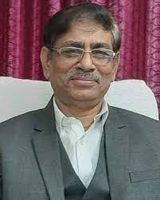
Central University of Jharkhand Viksit Bharat @2047: Voice of Youth Program
Patron: Honourable Vice Chancellor
Prof Kshiti Bhusan Das
Conveners
Institution’s Innovation Council, CUJ
Ek Bharat Shrestha Bharat, CUJ
National Service Scheme, CUJ
National Cadet Corps, CUJ
Date:18th December 2023
Event : Installation of Selfie Points in each Department

